Slide 1



Problem Statement No. 1 Develop a Police feedback system.
This Police Feedback System aims to improve transparency and efficiency by providing an accessible, real-time platform for community members to share their experiences and feedback on police interactions.

Slide 2
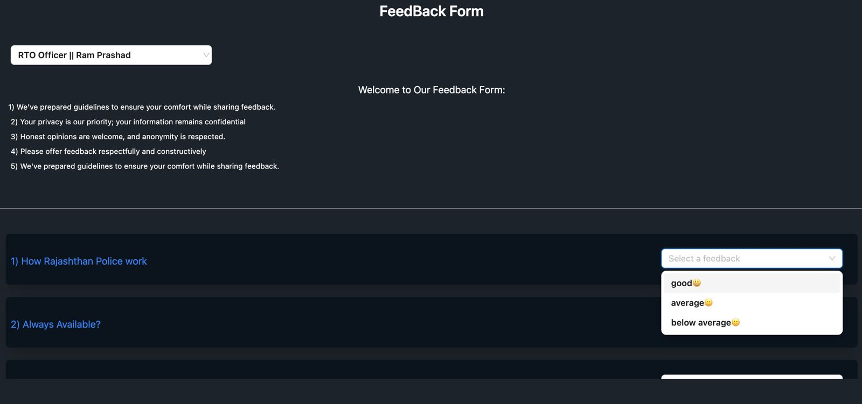
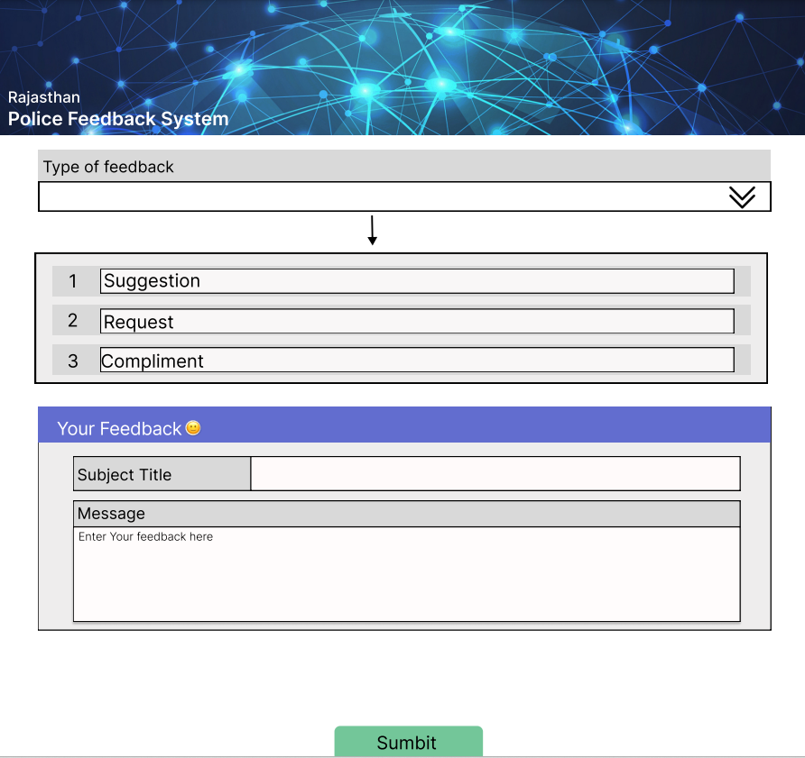
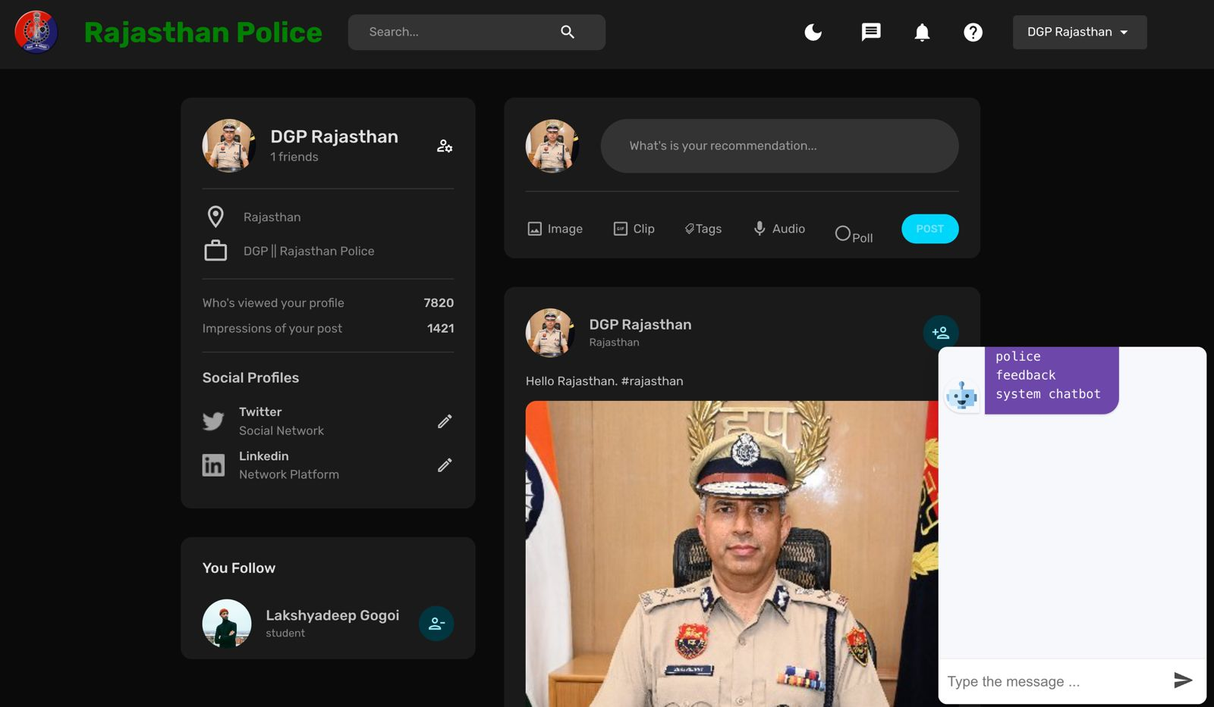
Idea/Approach Details
Rating Based Feedback Section:
Users can provide feedback through a user-friendly dropdown menu, assigning ratings out of 5 on various aspects.
Admin has the flexibility to customize aspects based on specific needs
Detailed feedback section:
Users can share detailed feedback, providing a more nuanced perspective on their experiences.
Community Section:
A social media-like platform facilitates interaction between citizens and the police.
Open platform to express concerns on various loopholes.
Get updates like new rules/Regulations.
Develop Awareness.
Chatbot assistant to clear common queries.
Transparency fosters trust

Slide 3

Sub-Problems/Stopper:
To mitigate spam and manage sensitive comments, an authentication mechanism will be implemented.
1
Admin has the authority to add or modify aspects for feedback Implementation.
2
Protecting users' privacy by concealing their account and personal details when providing feedback.
3

Slide 4
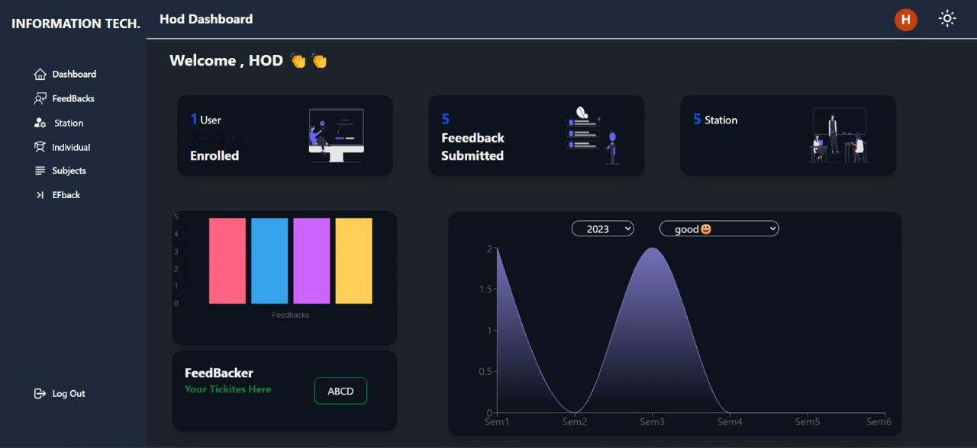
Analysis Methodology:
2-TIER feedback management system
State Level:
Graphical representation of feedback of whole state.(District wise)
District Level:
Analysis of feedback block wise and at the individual police station level.

Slide 5

Future Plans/Approach
Automated Calling System (Offline Mode):
Users will receive a call within 24 hours of registering a complaint or service request.
A bot will guide the user through a series of questions to gather feedback

